Slide 1

The all-in-one package:
Medicare Advantage
Prescription Drug Plans
1016
Notes:
601752.0715 / CMS Approved 08/26/2015

Slide 2
Today’s Topics
Medicare Overview
Medicare Advantage Plan Overview
Why choose a Blue Cross Medicare AdvantageSM Plan
Blue Cross Medicare AdvantageSM
Enrolling in a Blue Cross Medicare Advantage Plan
Blue Cross Medicare Advantage Plan Extras
Questions

Slide 3
Your Presenter Today
Presenter Name, Presenter Title
I am an Authorized Agent licensed to sell health insurance in Oklahoma and have been certified to sell Medicare Advantage and Prescription Drug Plan products for
Blue Cross and Blue Shield of Oklahoma. I may be compensated based upon your enrollment in a plan.
I am here to help you make an informed decision about selecting a Medicare Advantage Prescription Drug Plan.
Non discrimination notice→

Slide 4
Medicare Basics

Slide 5

When are you eligible for Medicare?
Age 65 or older
Under 65 with certain disabilities
Any age with End-Stage Renal Disease
(ESRD – permanent kidney failure
requiring dialysis or a kidney transplant)

Slide 6




Medicare Overview
Part A
Hospitalization
Insurance
Part B
Medical
Insurance
Medigap
Covers some of
what A & B don’t
Part C
Includes A & B, often has Part D
Part D
Prescription
Drugs

Slide 7
What is a Medicare Advantage Plan?
A Medicare Advantage Plan (Part C or MA Plan) is a private health insurance
plan that provides all of the benefits of Original Medicare (Parts A & B)
Some MA plans include prescription drug coverage (Part D) and are
referred to as Medicare Advantage Prescription Drug plans (MAPD)
Think of MAPD as your all-in-one plan, covering all your hospital
and medical insurance and prescription drugs
If you join or already are a member of a Medicare Advantage Plan, you cannot purchase or be sold a Medicare Supplement Insurance Plan
A
+
B
+
D
C
+
D
MAPD
=
=
Hospital
Medical
Rx Drug
Hospital &
Medical
Rx Drug
All-In-One Coverage

Slide 8

Medicare Advantage Plans: Key Points
When you join a Medicare Advantage Plan,
you are still in the Medicare program
The plan must offer the same benefits
as Original Medicare (Part A & Part B)
  Usually have different rules, costs, and
  restrictions for covering those services
Your Medicare-eligible services are
paid for by your plan
When you go to the doctor, you will show your plan’s Medicare Advantage card and NOT your Medicare card
Notes:
Mandatory:
If you enroll in a Medicare Advantage Plan you will need to continue paying your Medicare Part B premium as well as any premium charged by the plan you choose.

Slide 9
Medicare Advantage
Plan Options

Slide 10


Why choose a Blue Cross
Medicare Advantage Plan?
Choose our HMO plan that includes
Plan Extras!
Discounts for health care products and services
Low copay for visits to your
primary care doctor and specialists
This information is not a complete description of benefits. Contact the plan for more information. Limitations, copayments, and restrictions may apply. Benefits, premiums and/or co-payments/co-insurance may change on January 1 of each year.
Notes:
If you are new to Medicare, we encourage you to look at your options. Health changes can happen suddenly and are usually not expected. You want to protect yourself and have peace of mind that you’re covered if something comes up.
• HMO – Health Maintenance Organization
In most HMOs, you can only go to doctors, specialists, or hospitals on the plan’s list except in an emergency. You may also be required to get a referral from your primary care physician prior to visiting a specialist.
• HMO POS– Health Maintenance Organization Point of Service
In HMO POS plans, you have the choice to go to doctors, specialists, or hospitals on the plan’s network and there are some services that are allowed outside of the network.
OTC (Over-The-Counter) Card
not available on this plan

Slide 11

Why choose a Blue Cross
Medicare Advantage Plan?
Prescription drug coverage is included
  Generic prescription drug copays are low
  Blue Cross Medicare Advantage has
  pharmacies nationwide, giving you
  peace of mind while traveling
Certain MAPD plans will cover all drugs
in Tier 1 and Tier 2 in the Part D coverage gap
  For a 30-day supply, members will pay $0-$5 for Tier 1 drugs
  and $14-$19 for Tier 2 drugs; the lower copay amounts apply
  at our preferred network pharmacies
This information is not a complete description of benefits. Contact the plan for more information. Limitations, copayments, and restrictions may apply. Benefits, premiums and/or co-payments/co-insurance may change on January 1 of each year.

Slide 12

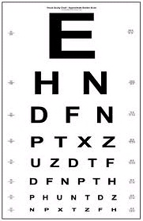

Value-Added Benefits
Additional Benefits that may be part of your plan:
Dental
Vision
Hearing

Slide 13
Blue Cross Medicare Advantage Plans
Preventive Care and Additional Services:
$0 copay for annual physical exams (in-network)
$80 copay for emergency care
Travel Benefits: Available for members who are
out of the service area for up to 6 months
This information is not a complete description of benefits. Contact the plan for more information. Limitations, copayments, and restrictions may apply. Benefits, premiums and/or co-payments/co-insurance may change on January 1 of each year.

Slide 14
Blue Cross Medicare Advantage
Built-in Prescription Drug Coverage
What counts toward the Initial Coverage Limit?
Initial Coverage Limit: $3,750
Deductible $0
Your copayments/coinsurance
Plan payments
Deductible
$0
Initial Limit
$3,750
The Gap
$4,700
$4,750
Catastrophic

Slide 15
Blue Cross Medicare Advantage
Built-in Prescription Drug Coverage
Coverage Gap: $3,750 to $5,000
You will reach the Coverage Gap
after you and your plan have reached
$3,750 in drug costs
Certain MAPD plans will cover all drugs
on Tier 1 and Tier 2 in the Part D
coverage gap until you reach $5,000
in True Out-Of-Pocket (TrOOP) costs
Deductible
$0
Initial Limit
$3,750
TrOOP
$5,000
Catastrophic
Notes:
Does NOT Count Toward TrOOP:
Medicare prescription drug plan premiums
Most third-party payment arrangements
Drugs purchased outside the U.S.
Over-the-counter drugs
Drugs not on the plan’s formulary

Slide 16
Blue Cross Medicare Advantage
Built-in Prescription Drug Coverage
Deductible
Troop Limit: $5,000
$0
Initial Limit
$3,750
TrOOP
$5,000
Catastrophic

Slide 17
Enrolling in a Blue Cross Medicare Advantage Plan

Slide 18
Requirements to Enroll in a
Blue Cross Medicare Advantage Plan
You must have Medicare Part A and Part B coverage
  Must be enrolled in Part B and continue to pay your Part B premium
You live in the service area of the plan you want to join
You do NOT have End-Stage Renal Disease
(permanent kidney failure requiring dialysis or
a kidney transplant) at the time of enrollment

Slide 19
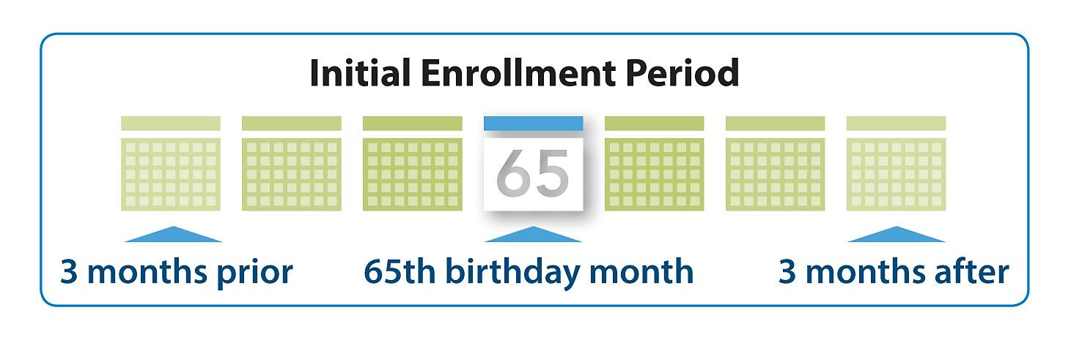
Three Enrollment Periods
1. Annual Enrollment Period (AEP)
  October 15 to December 7
  Enroll for the first time or switch plans
  Effective date: January 1
2. Initial Enrollment Period (IEP)
  Enroll when you first become eligible
    7-month period that starts 3 months
    before the month you turn 65, includes the month you turn 65,
    and ends 3 months after the month you turn 65
  Effective date: generally, first of the month following enrollment,
  or first of birthday month
3. Special Enrollment Period (SEP)
  Enroll or switch plans due to special circumstances
  Effective date: generally, first of the month following enrollment
Notes:
There are three enrollment periods.
1. The Annual Coordinated Election Period (AEP) (open enrollment) allows people to:
-change their Medicare prescription drug plan
-enroll in a prescription drug plan
-or disenroll from a Medicare prescription drug plan.
2. The Initial Enrollment Period (IEP) allows people to enroll in a Medicare prescription drug plan when they are first eligible for Medicare prescription drug coverage.
3. And last is the Special Enrollment Periods (SEP).
Moving to a new state
Moving into or out of a nursing home
Enrolling in or disenrolling from a Medicare Advantage plan
Eligible for Low Income Subsidy assistance
Enrolling in both Medicare and Medicaid
Retiree losing Group Medical coverage
Other situations that may be applicable

Slide 20


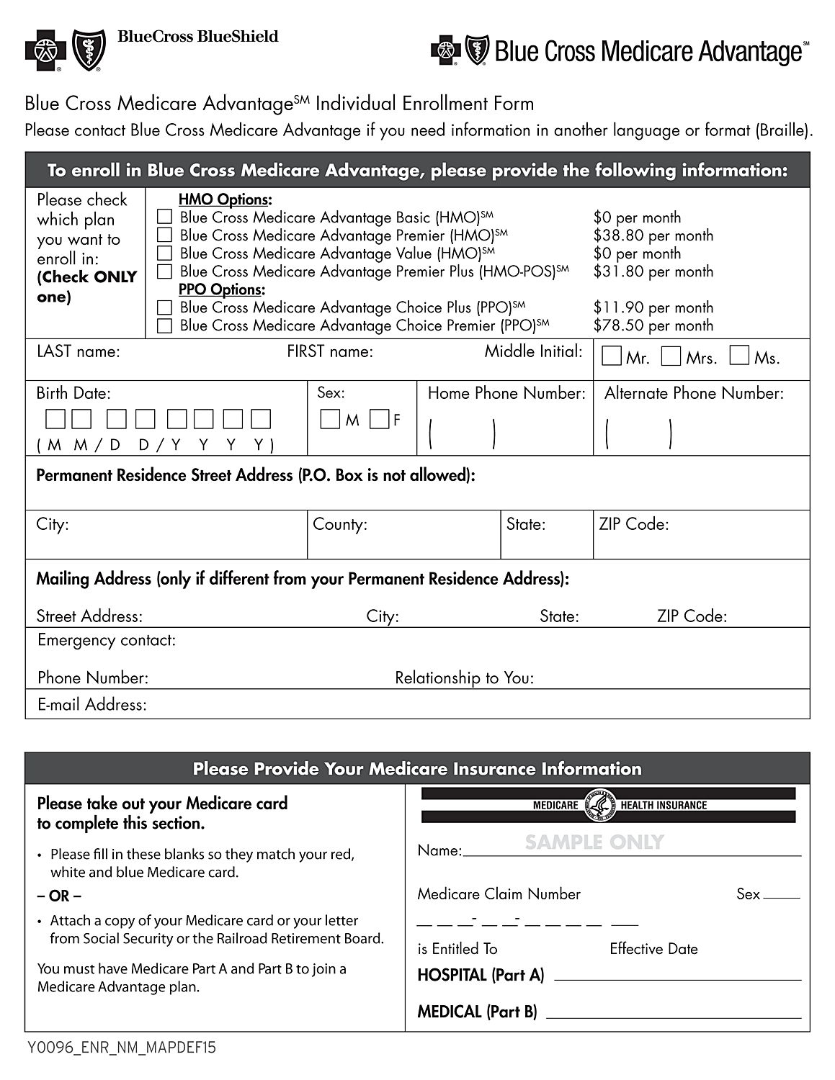
Ready to Enroll?
Next Steps
Meet with an Authorized Agent
  Review the Summary of Benefits
  Complete the Enrollment Application

Slide 21
The Disenrollment Period
January 1 to February 14:
If you would like to change your Medicare coverage, you may choose to disenroll from your Medicare Advantage Plan and switch to Original Medicare (Part A and Part B) and purchase a stand-alone Part D (PDP) plan.
During this period, you cannot do the following:
  Switch from Original Medicare to a Medicare Advantage Plan
  Switch from one Medicare Advantage Plan to another
  Switch from one Medicare Prescription Drug Plan to another
  Join, switch, or drop a Medicare Medical Savings Account Plan

Slide 22
Blue Cross Medicare
Advantage Plan Extras

Slide 23


SilverSneakers®†Fitness Program
SilverSneakers
Fitness classes
Social events
Health education
seminars
Blue Cross®, Blue Shield® and the Cross and Shield Symbols are registered service marks of the
Blue Cross and Blue Shield Association, an association of independent Blue Cross and Blue Shield Plans.
†SilverSneakers® is a wellness program owned and operated by Tivity Health, Inc., an independent company. Tivity Health and SilverSneakers® are registered trademarks or trademarks of Tivity Health, Inc., and/or its subsidiaries and/or affiliates in the USA and/or other countries.

Slide 24
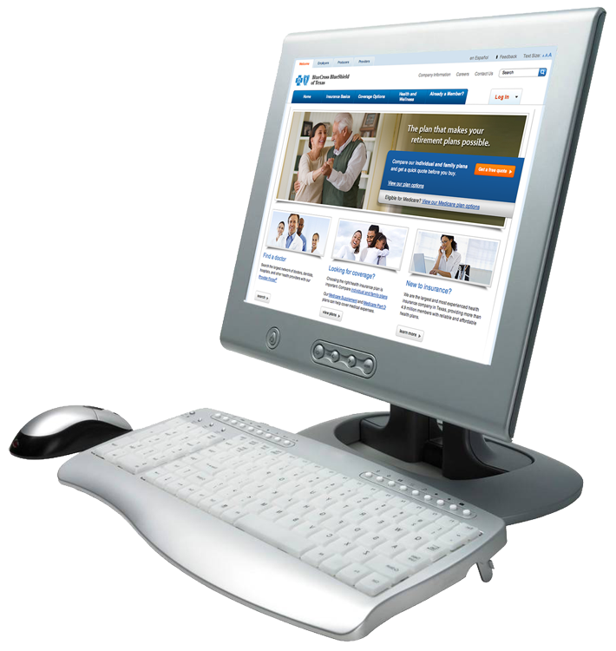
Taking Service a Step Further
Blue Access for MembersSM (BAM)
  Access wellness tools and resources
  View medical and pharmacy claims information
  Search available doctors and pharmacies
Education
  LifeTimes member email
  Seminars
  Health Fairs
  Community Events
  Visit www.bcbsok.com/medicare/seminars

Slide 25
Questions & Discussion

Slide 26
Resources
Medicare
  Visit www.medicare.gov
  1-800-MEDICARE (633-4227), 24 hours a day,
  7 days a week
  TTY 1-877-486-2048, 24 hours a day, 7 days a week
Social Security
  Visit www.ssa.gov
  1-800-772-1213, Monday-Friday, 7 a.m. - 7 p.m.
  TTY1-800-325-0778, Monday-Friday, 7 a.m. - 7 p.m.
Notes:
There are a number of sources where you can get more information, including:
Medicare’s website for people with Medicare, www.medicare.gov
Medicare’s website for partners, www.cms.hhs.gov
Social Security’s website www.socialsecurity.gov
Order publications such as the Medicare & You handbook or Facts About Medicare Prescriptions Drug Plans. They can be ordered from the website or by calling 1-800-MEDICARE
The toll-free number for Medicare, 1-800-MEDICARE (1-800-633-4227) and 1-877-486-2048 for TTY users
The toll-free number for Social Security, 1-800-772-1213 and 1-800-325-0778 for TTY users

Slide 27
Additional Information
  HMO plan available in the following Oklahoma counties: Canadian, Cleveland, Grady, Lincoln, Logan, Oklahoma, Okmulgee, Pottawatomie
  HMO plan provided by Blue Cross and Blue Shield of Oklahoma, which refers to GHS Health Maintenance Organization, Inc. d/b/a BlueLincs HMO (BlueLincs). BlueLincs is an Independent Licensee of the Blue Cross and Blue Shield Association. BlueLincs is a Medicare with a Medicare contract. Enrollment in BlueLincs’ plan depends on contract renewal.
  Prescription drug plan is provided by Blue Cross and Blue Shield of Oklahoma, which refers to HCSC Insurance Services Company (HISC), an Independent Licensee of the Blue Cross and Blue Shield Association. A Medicare-approved Part D sponsor. Enrollment in HISC’s plan depends on contract renewal.

Slide 28

Pre-Enrollment Kits
We have complete information kits
with enrollment forms available.
Notes:
[BCBSOK Dec. Guide]

Slide 29
Enroll Today
in Blue Cross
Medicare Advantage

